Slide 1
Project NMS: Development phase
Remy Bien
Sebastiaan Groot
Wouter Miltenburg
Koen Veelenturf

Slide 2
Content
Overview
Introduction (A quick summary of the previous presentation)
Project definition
Scope & MoSCoW
Functions
Manage Devices
ACL
Tech talk (it gets interesting here)
ACL
Parser
Security (passwords)
Demo (show the product)
Demo
Scope & MoSCoW
Test phase (test our product and make XML-files)

Slide 3
Introduction A quick summary of the previous presentation

Slide 4
Project Definition
Goal:
Network Management System (NMS) is a network device management web-application, to be released under a free, open-source license with multi-vendor support.
Target Group:
System Administrators.

Slide 5
Scope & Moscow
Must
The system must support CISCO devices;
The system must be able to open or shutdown network ports;
The system must make use of a database such as SQlite;
The system must have pluggable support.
Should
The backend should be python based;
The system should have multi-vendor support;
The system should have a nice modern looking interface;
The system should support user authentication.
Could
The system could have ACL (access control list) rules;
The system could have multi database support;
The system could have an auto-detection mechanism (e.g. OS version).
Won’t
The system won’t have multi-language support.

Slide 6
Functions How our product can make Network Management easier

Slide 7
Manage Devices
Create OS, model, type, XML-file and generic device
Create device (i.e. The one you would like to manage)
You are set and ready to go

Slide 8
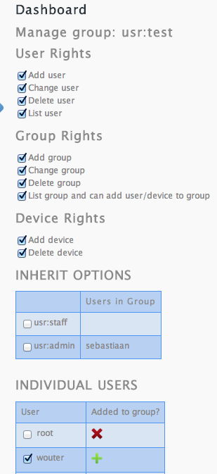
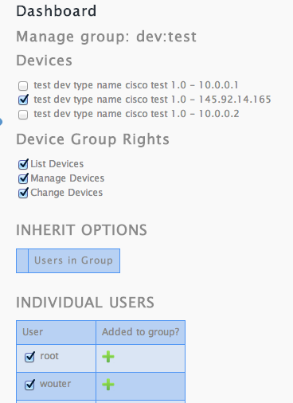
ACL
Manage the following entities:
Users
User/Device Groups
Device (i.e. Manage relationships between
users/groups and devices)
User groups:
Made specific for
user rights
Device groups:
Made specific for
device rights

Slide 9
Tech Talk it gets interesting here

Slide 10
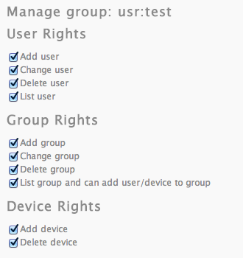
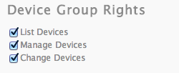
Acl
Why device groups and user groups
How authorization works
How we protect our handlers
How users, groups and devices can be managed
using ACL
Inheritance

Slide 11
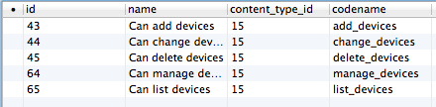
ACL – simple check

Slide 12
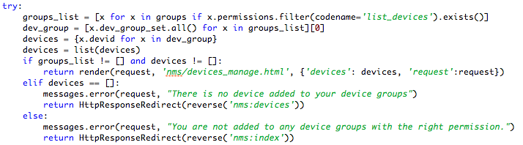
ACL – a bit more advanced

Slide 13
Parser
Dynamic interface querying
Obtaining port names from each device
Pre-defined tasks in device-specific XML
Tasks can be single or per-interface tasks
Tasks can contain user-supplied arguments
IP address, subnet mask etc.
Almost everything is cached
No expensive calculations and I/O on every request

Slide 14
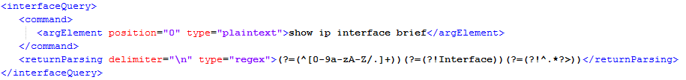
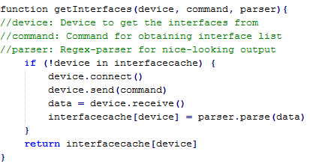
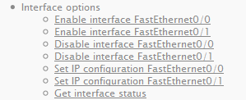
Dynamic interface querying

Slide 15
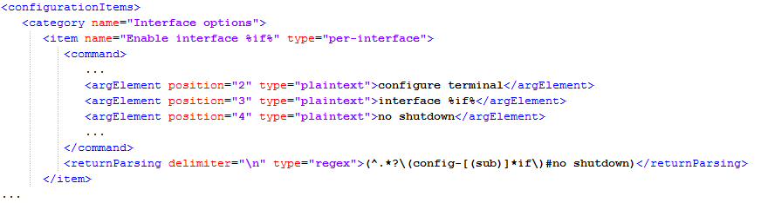
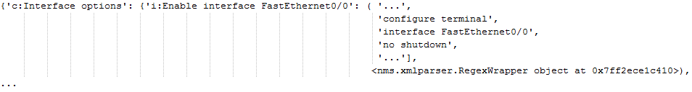
Tasks to CLI commands

Slide 16
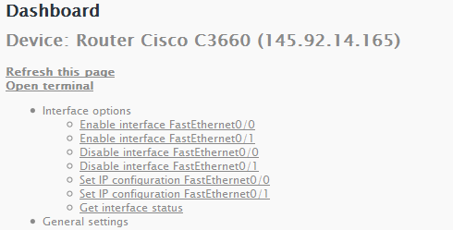
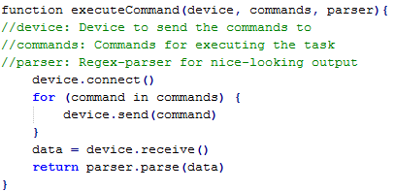
Tasks to CLI commands

Slide 17
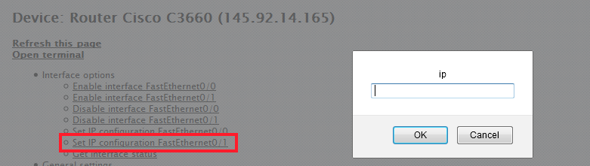
User-supplied arguments

Slide 18

Security (passwords)
AES-encryption for device passwords
Privileged mode and SSH passwords secured
Master-password + salt for each password

Slide 19
Demo Show the product

Slide 20
Demo
Show the product

Slide 21
Scope & Moscow
Must
The system must support CISCO devices;
The system must be able to open or shutdown network ports;
The system must make use of a database such as SQlite;
The system must have pluggable support.
Should
The backend should be python based;
The system should have multi-vendor support;
The system should have a nice modern looking interface;
The system should support user authentication.
Could
The system could have ACL (access control list) rules;
The system could have multi database support;
The system could have an auto-detection mechanism (e.g. OS version).
Won’t
The system won’t have multi-language support.

Slide 22
Test Phase Test our product and make XML-files

Slide 23
Test phase
Plan for the phase
Deadlines / milestones
Notes:
- Testrapport
- Release Candidate

Slide 24
Project Network Management System
Any Questions?

